Slide 1
Influencing compliance by university education
Kasia Bronzewska, IBFD
Porto Alegre, 20 November 2013

Slide 2

Compliance and education
What is compliance?
What compliance models exist?
No one-fits-all solution available:
Compliance tools available for TA;
Compliance and education;
OECD “Right from the start” approach (SMEs).
Examples from different countries.

Slide 3
Compliance and education
Compliance
Compliance tools
Education
Uni level edu

Slide 4
Compliance (1)
What is tax compliance?
The procedural and administrative actions needed to satisfy a taxpayer‘s obligations under the applicable tax rules.
TP group: Individuals v SMEs v large corporations
Culture: anecdotal evidence: “In America, if you cheat on your taxes your neighbours won't talk to you. In Italy, they'll ask you how you did it.“ Beppe Severgnini

Slide 5
Compliance (2)
Voluntary compliance is a system of compliance that relies on individual citizens to report their income freely and voluntarily, calculate their tax liability correctly, and file a tax return on time.
Is ‘voluntary’ really voluntary?
Default compliance is, for instance, the use of pre-filling. The individuals are compliant by default, their attitudes towards compliance do not matter any more.

Slide 6
Basic compliance models
Economic deterrence model
Assumes that the TP is a utility maximiser and the decisions concerning compliance are based on TP’s risk profile.
Social psychology models
Look at the impact of social stimuli and interaction on individual decision-making.
Fiscal psychology models
Mix of the economic deterrence and social psychology – economic/financial factors and TP’s characteristics and circumstances.

Slide 7
Non-compliance
Non compliance may result from:
negligence;
carelessness or recklessness;
ignorance (i.e. a lack of knowledge of the regulators view of compliance);
honest mistake;
not being in a position to comply; or
a difference of views as to what compliance is. This can range from reasonably arguable positions to the aggressive ones.

Slide 8
Compliance and education
Compliance
Compliance tools
Education
Uni level edu

Slide 9
Compliance tools available to TA:
Preventive tools:
  Communication;
  Engagement;
  Education;
  Rulings, guidance, policy;
Corrective tools;
Responsive tools:
  Audits, investigations;
  Prosecution, litigation.

Slide 10
Compliance (3)
Compliance enforcement
Compliance enforcement service engagement communication EDUCATION

Slide 11
Compliance and education
Compliance
Compliance tools
Education
Uni level edu

Slide 12
Compliance & education
  Communication, engagement and education walk hand in hand.
  Education – making individuals understand of what their obligation consist of and how to meet them.

Slide 13
Compliance & young people
  Younger (<30) people:
  Less compliant than middle-aged and older people;
  Less knowledgeable about tax issues;
  Less developed sense of moral obligation or law abidingness to pay tax;
  More sceptical about government authority.
  Next generation of taxpayers;

Slide 14
OECD, Right from the Start (2012)
  Education is an important element in addressing compliance risks up-front. Education works best when the person being taught is motivated and knows how to use the knowledge. The right education at the right time is therefore important.
  Educating young people as well as new immigrants about tax in a more general context could influence personal and social norms.
  Acting Right from the Start‘ implies that education should start at an early stage, for example, in high school, college and university.
  Social media can also play a role in this respect. This contributes to establishing an environment more conducive to compliance.

Slide 15
OECD, Right from the Start (2012)
  Example:
  Canadian trade school initiative:
  The initiative‘s goals are to target trade students and educate them on the requirements of the tax system as well as to caution them on participating in the underground economy.

Slide 16
Australian Taxation Office
  The secondary school education program helps students
  become prepared and educated about entering and interacting
  with the tax system. The program has three main elements:
  the secondary school tax file number (TFN) program
  tax and super educational resources
  school visits.

Slide 17
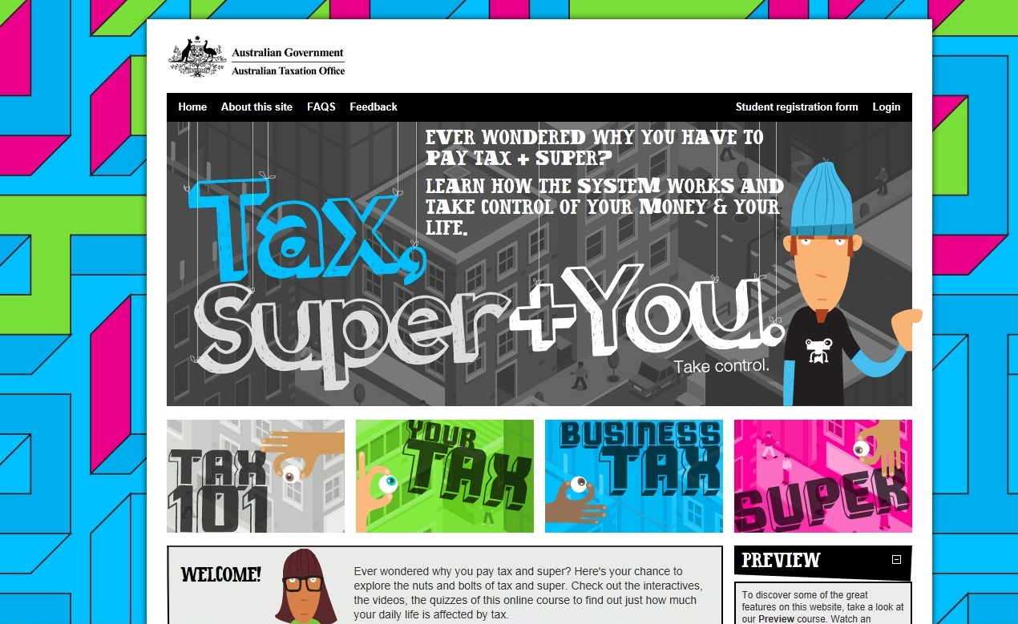
ATO, Tax Super + You

Slide 18
ATO, Tax Super + You
  Tax, Super + You teaches in a fun and engaging way how the Australian tax and super systems work, the benefits to the community and the role Australians play in supporting these systems. It has four modules:
  tax basics;
  personal tax;
  business tax;
  super.

Slide 19
Understanding Taxes, IRS
  Understanding Taxes – The quick and simple way to understand your taxes.
  Making real-world connections to classroom instruction is an important
  goal of educators. The IRS partnered with education professionals to
  bring you the Understanding Taxes Teacher Site, an interactive tax
  education program for middle school, high school and community college classrooms.

Slide 20
Understanding Taxes, IRS
  Student site:
  a set of 38 Understanding Taxes student lessons;
  Divided into 2 content areas:
  the Hows of Taxes (how to apply tax principles); and
  the Whys of Taxes (tax history and theory).

Slide 21
Thank you for your attention!
Kasia Bronzewska
k.bronzewska@ibfd.org

